Slide 1
EJB3 in Practise
Dat Do - Jan 2019 - v0.1

Slide 2
Outline
What ?
Why EJB3 ?
Where and When ?
How ?
Q&A
Notes:
Annotation (@EJB, @Inject), JNDI binding, will be mentioned within these session
Callbacks (@Postconstruct, @Predestroy, etc)
Consider Singleton/Load balancing in clustering

Slide 3
What?
EJB - Enterprise JavaBeans
Building enterprise app
Business logic development focus
No need to care about boilerplate parts
Security
Transaction
Automated persistence
...

Slide 4

2. Why?
Easy to use
Performance
Complete stack for server side
Broad vendor support
Stable
Enterprise level features ready
Notes:
Complete stack: Persistence, Messaging, Remoting, Scheduling, Web services, Interceptors
Broad vender support: IBM, Oracle, Redhat
Enterprise level feature: Load balancing, clustering, failover

Slide 5



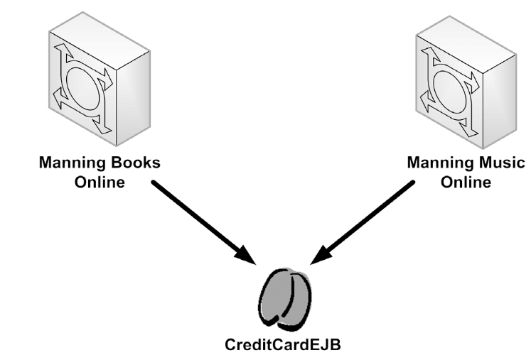
3. Where and when?
Remote access
Portability
Reusability
Scalability

Slide 6
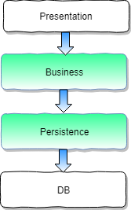
4. How to implement business logic?
Implement Business operations
Implement Messaging system
Implement clients

Slide 7
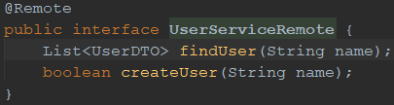

4. How?
Implement Business operations
Step 1: Create remote and/or local interface

Slide 8
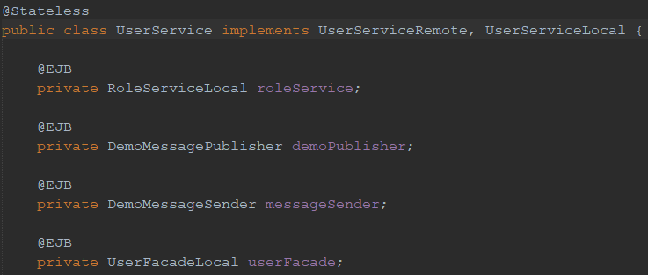
4. How?
Implement Business operations
Step 2: Create Stateless/Stateful bean

Slide 9
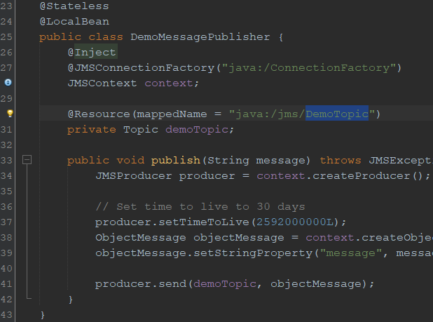
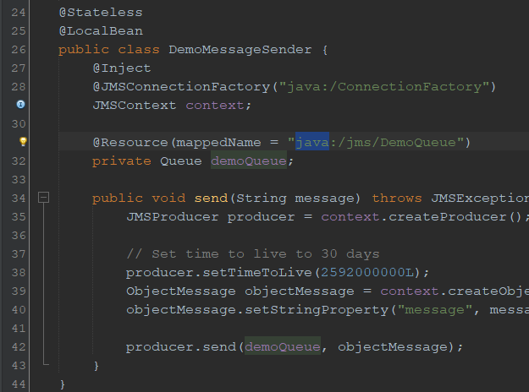
4. How?
Implement Messaging system
Implement Publisher/Sender

Slide 10
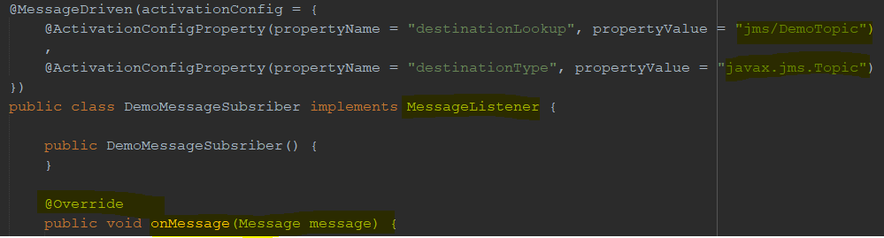
4. How?
Implement Messaging system
Implement Subscriber/Receiver

Slide 11
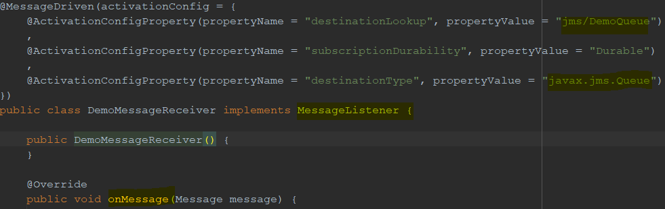
4. How?
Implement Messaging system
Implement Subscriber/Receiver

Slide 12
4. How?
Implement Messaging system
Create Topic/Queue

Slide 13
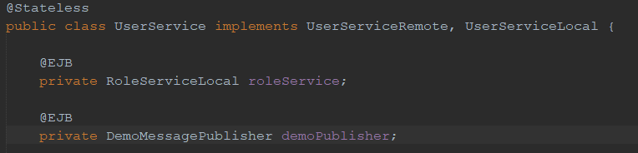
4. How to implement business logic?
Implement clients
Implement local client

Slide 14
4. How to implement business logic?
Implement clients
Implement remote client - standalone
Step 1. Add dependencies
Step 2. Create jndi property file
Step 3. Lookup remote interface
Step 4. Invoke remote methods

Slide 15
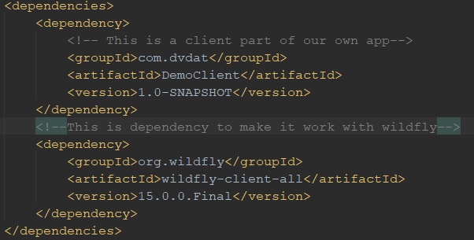
4. How to implement business logic?
Implement clients
Implement remote client - standalone
Step 1. Add dependencies

Slide 16
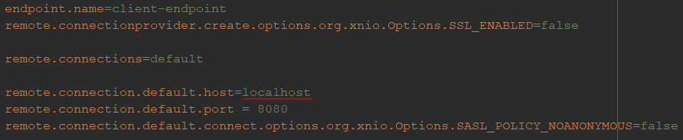
4. How to implement business logic?
Implement clients
Implement remote client - standalone
Step 2. Create jndi property file

Slide 17
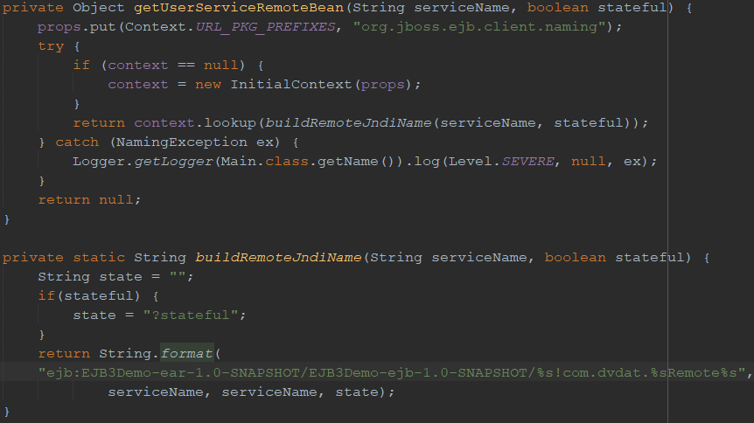
4. How to implement business logic?
Implement clients
Implement remote client - standalone
Step 3. Lookup remote interface

Slide 18

4. How to implement business logic?
Implement clients
Implement remote client - standalone
Step 4. Invoke remote methods

Slide 19
4. How?
Implement persistence layer
Step 1: Create table in database
Step 2: Create Entity class
Step 3: Create Datasource and Persistence Unit
Step 4: Create Db Manager with Entity Manager
Step 5: Add more operations

Slide 20
4. How?
Implement persistence layer
Step 1: Create table in database

Slide 21
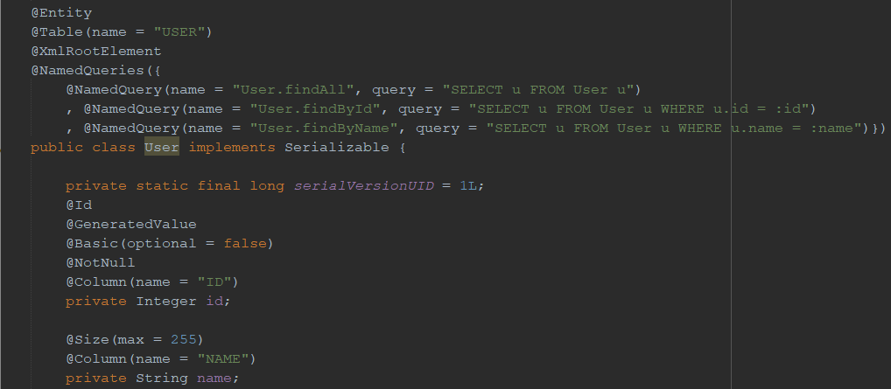
4. How?
Implement persistence layer
Step 2: Create Entity class

Slide 22
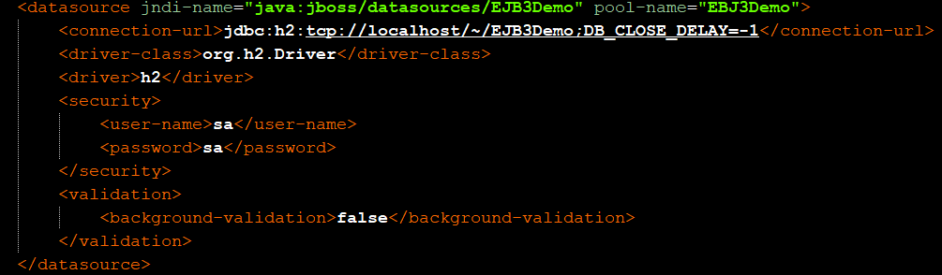
4. How?
Implement persistence layer
Step 3: Create Datasource and Persistence Unit

Slide 23
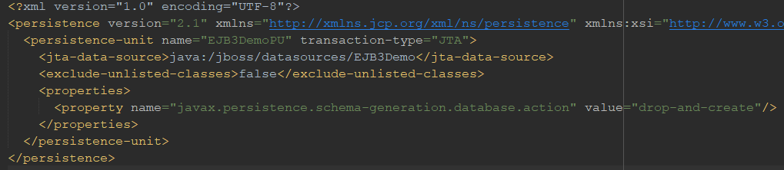
4. How?
Implement persistence layer
Step 3: Create Datasource and Persistence Unit

Slide 24
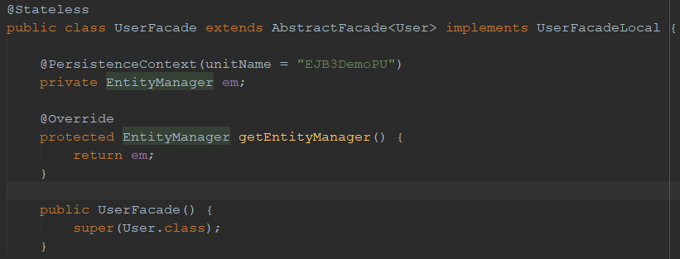
4. How?
Implement persistence layer
Step 4: Create Db Manager with Entity Manager

Slide 25
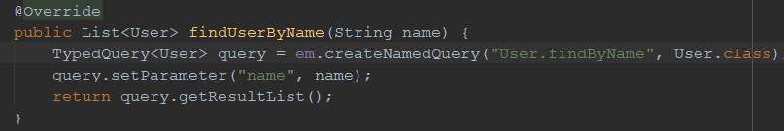
4. How?
Implement persistence layer
Step 5: Add operations

Slide 26
Reusability
Beans are independent promotes reusability
Remote bean allows to use from external system

Slide 27
Portability
Easy to switch to other containers
Easy to change DB server

Slide 28
How? Scalability - Another session :)
Load Balancing
Clustering
Failover

Slide 29
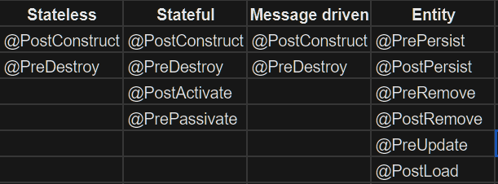
Supplementary
Callbacks

Slide 30
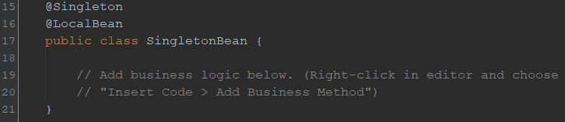
Supplementary
Singleton

Slide 31
Supplementary
Transaction
Type:
Container managed: Default @TransactionManagement(TransactionManagementType.CONTAINER) @TransactionAttribute(TransactionAttributeType.MANDATORY)

Slide 32
Supplementary
Transaction
Type:
Bean managed @TransactionManagement(TransactionManagementType.BEAN) … @Resource private UserTransaction userTransaction; … userTransaction.begin(); … userTransaction.commit(); … userTransaction.rollback()

Slide 33
References
https://www.tutorialspoint.com
EJB 3 in Action Debu Panda, Reza Rahman, Ryan Cuprak
https://docs.jboss.org/ejb3/app-server/tutorial/
Demo source code, slide and configuration https://github.com/jimmydo0704/EJB3Demo

Slide 34
Q & A

